Slide 1
Collaborative Filtering for Implicit Feedback
Slides available:
http://www.comp.nus.edu.sg/~xiangnan/papers/icf.pptx
Dr. He Xiangnan (何向南)
School of Computing
National University of Singapore
December 2016

Slide 2
Outline
Background
Work #1 (shallow model):
He et al. SIGIR 2016: Fast Matrix Factorization for Online Recommendation with Implicit Feedback
Work #2 (deep model):
He et al. WWW 2017: Neural Collaborative Filtering. http://www.comp.nus.edu.sg/~xiangnan/papers/ncf.pdf

Slide 3
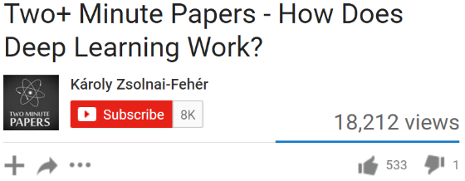

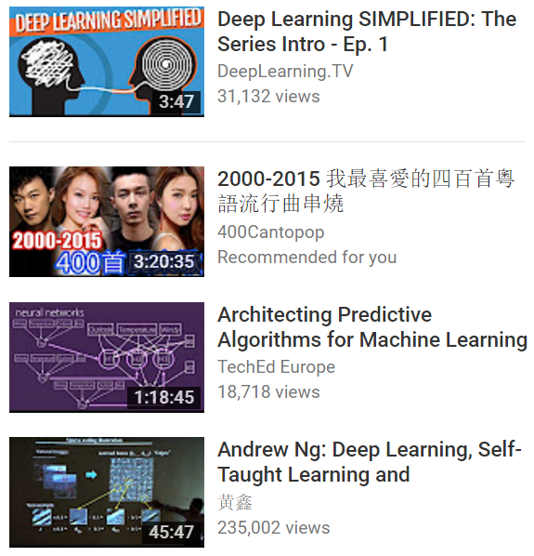

Value of Recommender System (RS)
Netflix: 60+% of the movies watched are recommended.
Google News: RS generates 38% more click-through
Amazon: 35% sales from recommendations
Statistics come from Xavier Amatriain
Notes:
In the age of information explosion, recommender systems play an important role in alleviating information overload, and have been widely adopted by many online services. For example…

Slide 4
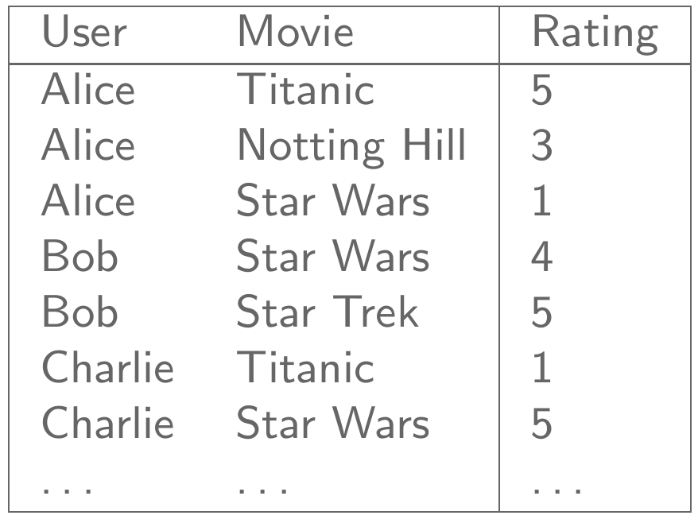
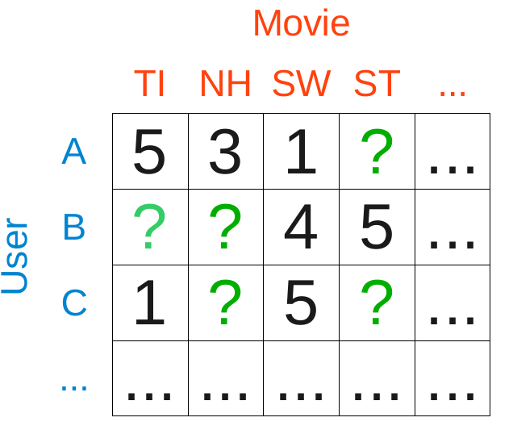
Collaborative Filtering (CF)
“CF makes predictions (filtering) about a user’s interest by collecting preferences information from many users (collaborating)”
1. Neighbor-based:
- Do prediction based on the similarity of users/items.
2. Model-based:
- Assume data is generated by an underlying model.
Notes:
CF is the core component of a modern RS. It means that to make prediction about a user’s interest, we should also look at the preferences information from many other users.

Slide 5
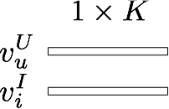
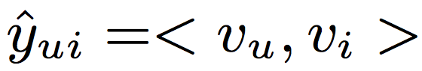
Matrix Factorization (MF)
MF is the most popular model-based CF technique:
Linear latent factor model:
User 'u' rated an item 'i'
Learn latent vector for each user, item:
Affinity between user ‘u’ and item ‘i’:

Slide 6
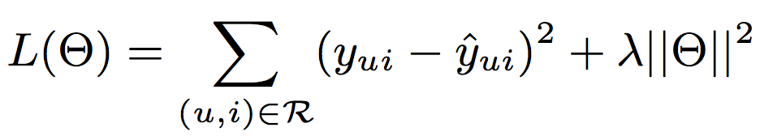
MF on Explicit Feedback
Explicit feedback, e.g. users’ ratings on movies, where a user explicitly indicates whether he/she likes an item or not.
Well-formed problem – both users’ positive & negative feedback are available.
Model:
Objective Function (regression):
Only observed ratings are considered!

Slide 7
But for Implicit Feedback…
Implicit feedback, e.g., users’ clicks/watches/purchases on items, where a user implicitly expresses his/her preference.
User 'u' rated an item 'i’, but we do not know whether he likes it or not!!
1 | 0 | 0 | 1
0 | 1 | 0 | 0
1 | 1 | 0 | 0
1 | 0 | 0 | 1
Due to the prevalence of implicit feedback, recent research on RS has shifted to implicit feedback!
users
More like a classification problem, rather than regression.
Unobserved data (0 entries) are crucial to consider!
0/1 Interaction matrix

Slide 8
Challenges for Learning from Implicit Feedback
The full user-item matrix need to be considered.
# of training instance: M ✕ N;
Unrealistic to deal with real-world data.
An ill-formed problem:
No true-negative preference data;
0 entries are a mixture of negative and unknown feedback.
1 | 0 | 0 | 1
0 | 1 | 0 | 0
1 | 1 | 0 | 0
1 | 0 | 0 | 1
0/1 Interaction matrix

Slide 9
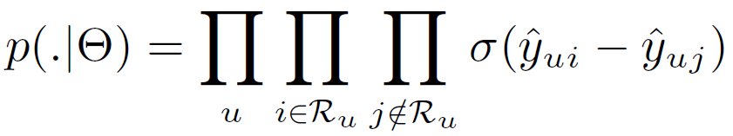
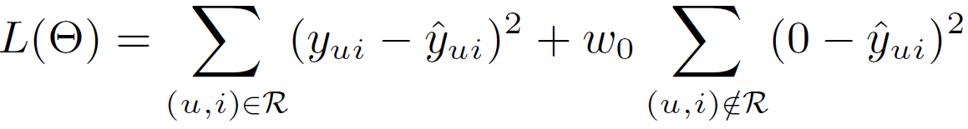
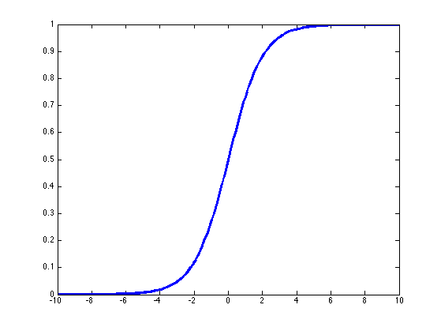
Previous Implicit MF Solutions
Pair-wise Ranking Method
(BPR, Rendle et al, UAI 2009)
Regression-based Method
(WALS, Hu et al, ICDM 2008)
Sampling negative instances:
Treating all missing data as negative:
LIKELIHOOD:
LOSS:
Weight for Missing data
Sigmoid:
Prediction on observed entries
Prediction for missing data
All Items
bought by u
Items not
bought by u
Work #1: Address both the effectiveness and efficiency issue of regression method.
Pros:
+ Efficient
+ Optimized for ranking (good precision)
Cons:
Only model partial data (low recall)
Pros:
+ Model the full data (good recall)
Cons:
Less efficient
Uniform weighting on missing data.

Slide 10
Work #1: SIGIR 2016. Fast Matrix Factorization for Online Recommendation with Implicit Feedback.
Drawbacks of Existing Methods
(whole-data based)

Slide 11
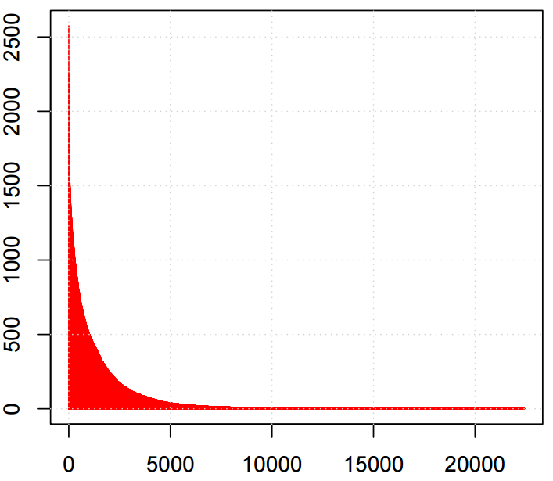
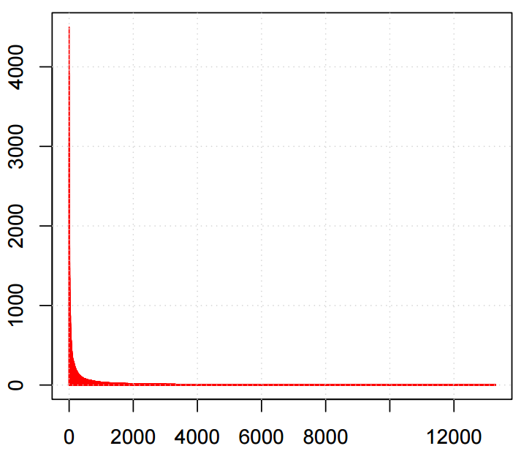
Drawback #1: Uniform Weighting - Limits model’s fidelity and flexibility
Uniform weighting on missing data assumes that
“all missing entries are equally likely to be a negative assessment.”
The design choice is for the optimization efficiency --- an efficient ALS algorithm (Hu, ICDM 2008) can be derived with uniform weighting.
However, such an assumption is unrealistic.
Item popularity is typically non-uniformly distributed.
Popular items are more likely to be known by users.
BBC Video
Tag: ECML'09 Challenge
Selection Frequency
Selection Frequency
Video Rank
Tag Rank
Figures adopt from Rendle, WSDM 2014.

Slide 12
Drawback #2: Low Efficiency - Difficult for large-scale data
An analytical solution known as ridge regression
Vector-wise ALS
Time complexity: O((M+N)K³ + MNK²)
M: # of items, N: # of users, K: # of latent factors
With the uniform weighting, Hu can reduce the complexity to O((M+N)K³ + |R|K²)
|R| denotes the number of observed entries.
However, the complexity is too high for large dataset:
K can be thousands for sufficient model expressiveness
e.g. YouTube RS, which has over billions of users and videos.
Scary complexity and unrealistic for practical usage

Slide 13
Drawback #3: - Difficult to support online learning
Scenario of Recommender System:
New data continuously streams in:
New users;
Old users have new interactions;
It is extremely useful to provide instant personalization for new users, and refresh recommendation for old users, but retraining the full model is expensive
=> Online Incremental Learning
Historical data
New data
Training
Recommendation
Time

Slide 14
Key Features
Our method:
Non-uniform weighting on Missing data
An efficient learning algorithm (K times faster than Hu’s ALS, the same magnitude with BPR-SGD learner)
Seamlessly support online learning.

Slide 15
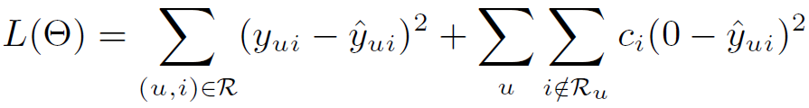
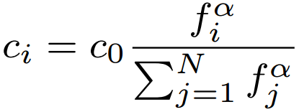
#1. Item-Oriented Weighting on Missing Data
Old Design:
Our Proposal:
The confidence that item i missed by users is a true negative assessment
Popularity-aware Weighting Scheme:
Intuition: a popular item is more likely to be known by users, thus a missing on it is more probably that the user is not interested with it.
Similar to frequency-aware negative sampling in word2vec.
Smoothness: 0.5 works well
Overall weight of missing data
Frequency of item

Slide 16
#2. Optimization (Coordinate Descent)
Existing algorithms do not work:
SGD: needs to scan all training instance O(MN).
ALS: requires a uniform weight on missing data.
We develop a Coordinate Descent learner to optimize the whole-data based MF:
Element-wise Alternating Least Squares Learner (eALS)
Optimize one latent factor with others fixed (greedy exact optimization)
Property | eALS (ours) | ALS (traditional)
Optimization Unit | Latent factor | Latent vector
Matrix Inversion | No | Yes (ridge regression)
Time Complexity | O(MNK) | O((M+N)K³ + MNK²)

Slide 17
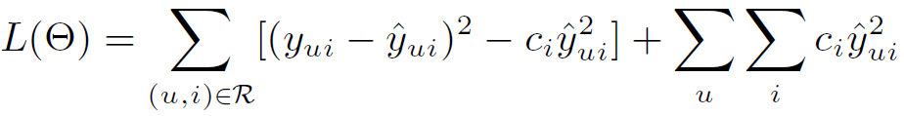
#2.1 Efficient eALS Learner
An efficient learner by using memoization.
Key idea: memoizing the computation for missing data part:
Reformulating the loss function:
Bottleneck: Missing data part
Sum over all user-item pairs, can be seen as a prior over all interactions!
This term can be computed efficiently in O(|R| + MK²), rather than O(MNK). Algorithm details see our paper.

Slide 18
#2.2 Time Complexity
# of latent factors
O((M+N)K² + |R|K)
# of users
# of items
# of observed ratings
Linear to data size!

Slide 19
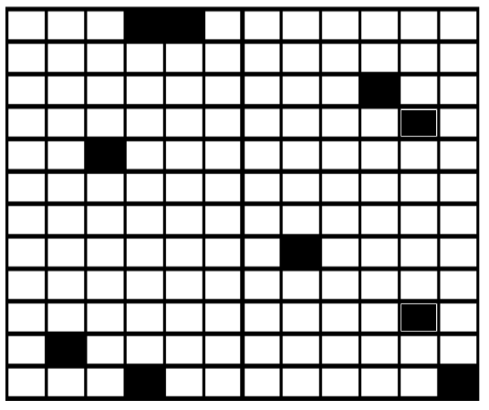
#3. Online Incremental Learning
Items
Given a new (u, i) interaction, how to refresh model parameters without retraining the full model?
Users
Our solution: only perform updates for v_{u} and v_{i}
We think the new interaction should change the local features for u and i significantly;
While the global picture remains largely unchanged.
Black: old training data
Blue: new incoming data
Pros:
+ Localized complexity: O(K² + (|R_{u}| + |R_{i}|)K)

Slide 20
Outline
Background
Work #1 (shallow model):
Existing Work
Method
Experiments
Offline Evaluation
Online Evaluation
Work #2 (deep model):
He et al. WWW 2017. Neural Collaborative Filtering.

Slide 21
Dataset & Baselines
Two public datasets (filtered at threshold 10):
Yelp Challenge (Dec 2015, ~1.6 Million reviews)
Amazon Movies (SNAP.Stanford)
Baselines:
ALS (Hu et al, ICDM’08)
RCD (Devooght et al, KDD’15)
Randomized Coordinate Descent, state-of-the-art implicit MF solution.
BPR (Rendle et al, UAI’09)
SGD learner, Pair-wise ranking with sampled missing data.
Dataset | Interaction# | Item# | User# | Sparsity
Yelp | 731,671 | 25.8K | 25.7K | 99.89%
Amazon | 5,020,705 | 75.3K | 117.2K | 99.94%

Slide 22
Offline Protocol (Static data)
Leave-one-out evaluation (Rendle et al, UAI’09)
Hold out the latest interaction for each user as test (ground-truth).
Although it is widely used in literatures, it is an artificial split that does not reflect the real scenario.
Leak of collaborative information!
New users problem is averted.
Top-K Recommendation (K=100):
Rank all items for a user (very time consuming, longer than training!)
Measure: Hit Ratio and NDCG.
Parameters: #factors = 128 (others are also fairly tuned, see the paper)

Slide 23
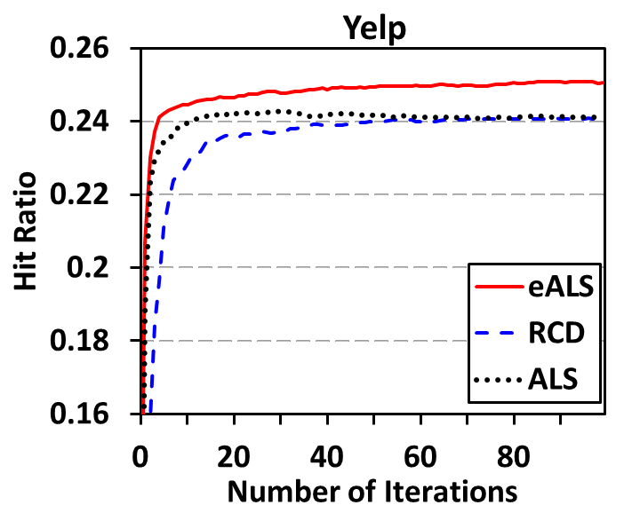
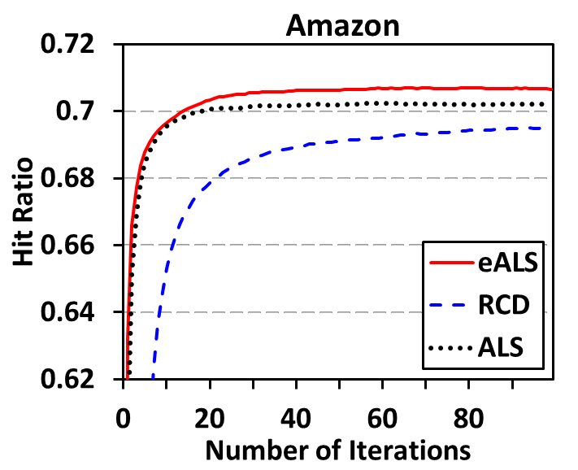
Compare whole-data based MF
eALS > ALS: popularity-aware weighting on missing data is useful.

Slide 24
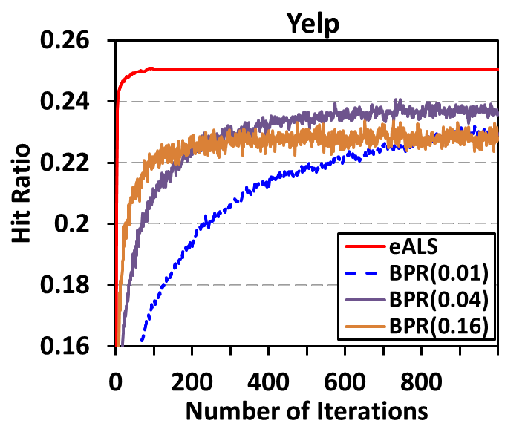
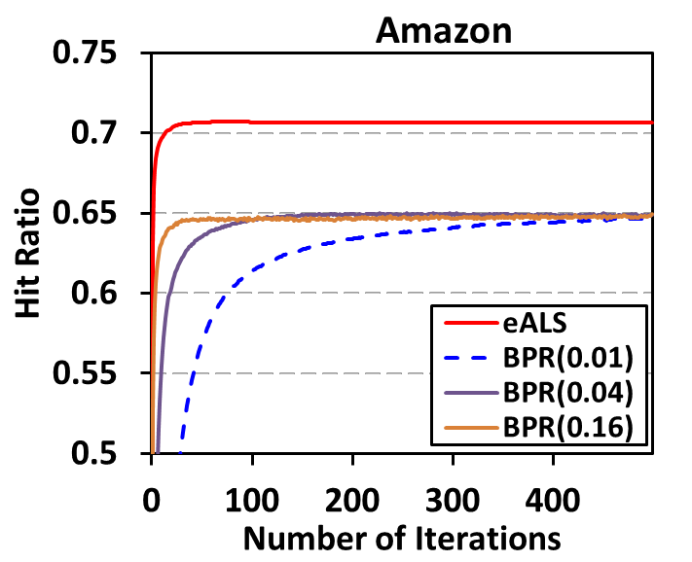
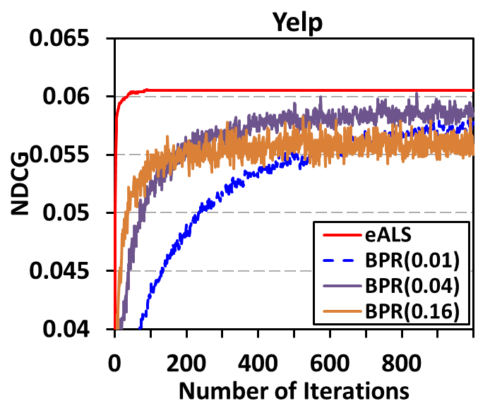
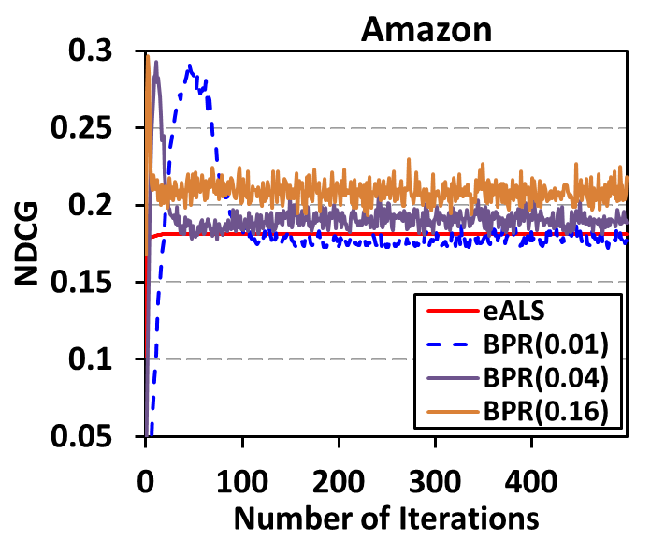
Compare with Sampled-based BPR
Observation:
1. BPR is a weak performer for Hit Ratio
(low recall, as it samples partial missing data only)
2. BPR is a strong performer for NDCG
(high precision, as it optimizes a ranking-aware function)
Hit Ratio
NDCG

Slide 25
Efficiency Comparison
Training time per iteration (Java, single-thread)
 | Yelp (0.73M) |  | Amazon (5M)
Factor# | eALS | ALS | eALS | ALS
32 | 1 s | 10 s | 9 s | 74 s
64 | 4 s | 46 s | 23 s | 4.8 m
128 | 13 s | 221 s | 72 s | 21 m
256 | 1 m | 23 m | 4 m | 2 h
512 | 2 m | 2.5 h | 12 m | 11.6 h
Analytically:
eALS: O((M+N)K² + |R|K)
ALS: O((M+N)K³ + |R|K²)
We used a fast matrix inversion algorithm: O(K^{2.376})
eALS has the similar running time with RCD (KDD’15), which only supports uniform weighting on missing data.

Slide 26
Online Protocol (dynamic data stream)
Sort all interactions by time
Global split at 90%, testing on the latest 10%.
In the testing phase:
Given a test interaction (i.e., u-i pair), the model recommends a Top-K list to evaluate the performance.
Then, the test interaction is fed into the model for an incremental update.
New users problem is obvious:
57% (Amazon) and 14% (Yelp) test interactions are from new users!
Historical data (offline)
New Interactions (online)
Training (90%)
Evaluate & Update
Time

Slide 27
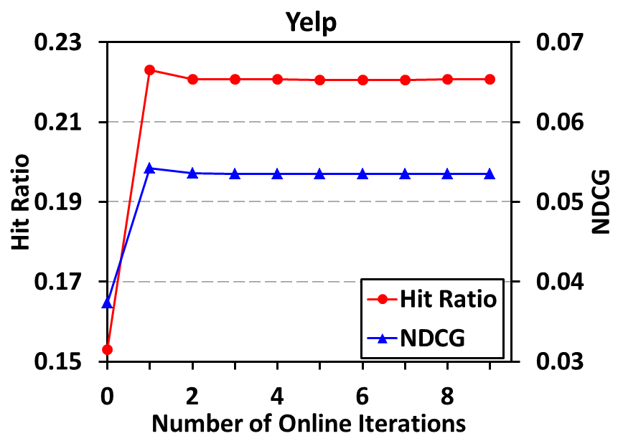
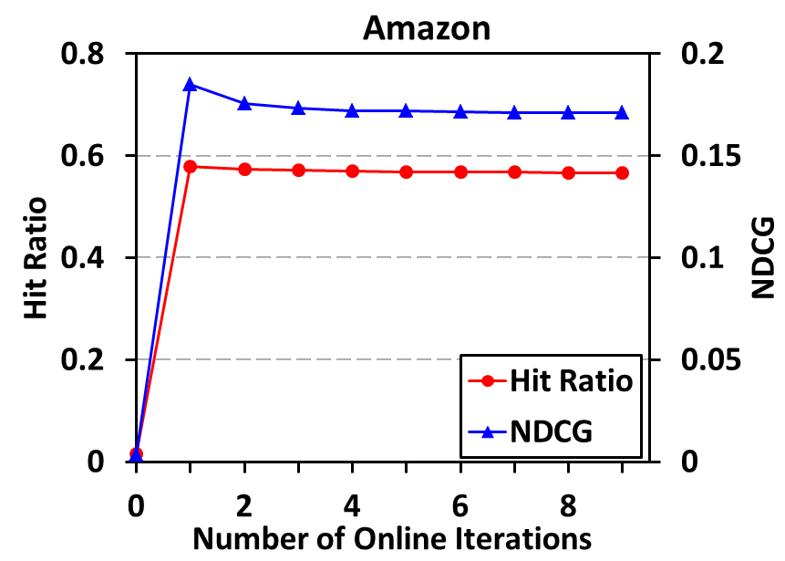
Number of Online Iterations
Impact of online iterations on eALS:
Offline training
Offline training
One iteration is enough for eALS to converge!
While BPR (SGD) needs 5-10 iterations.

Slide 28
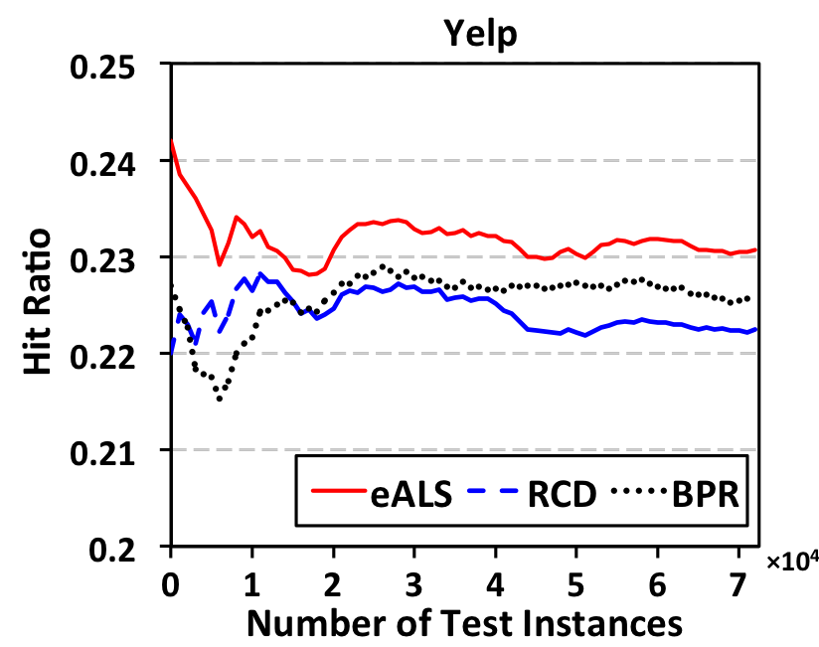
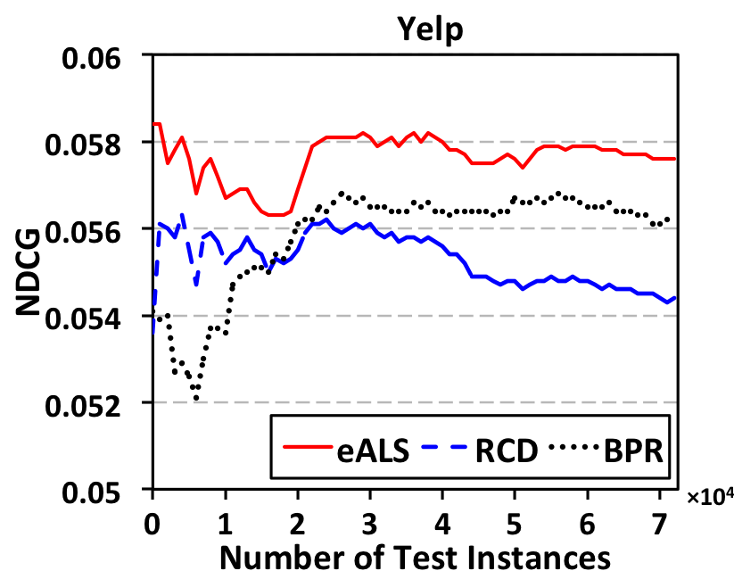
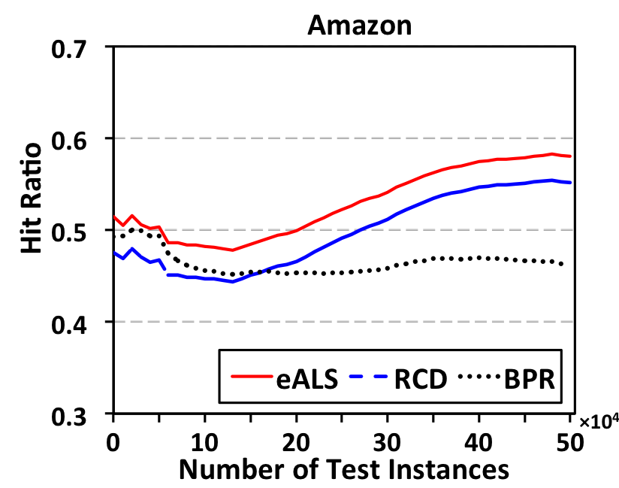
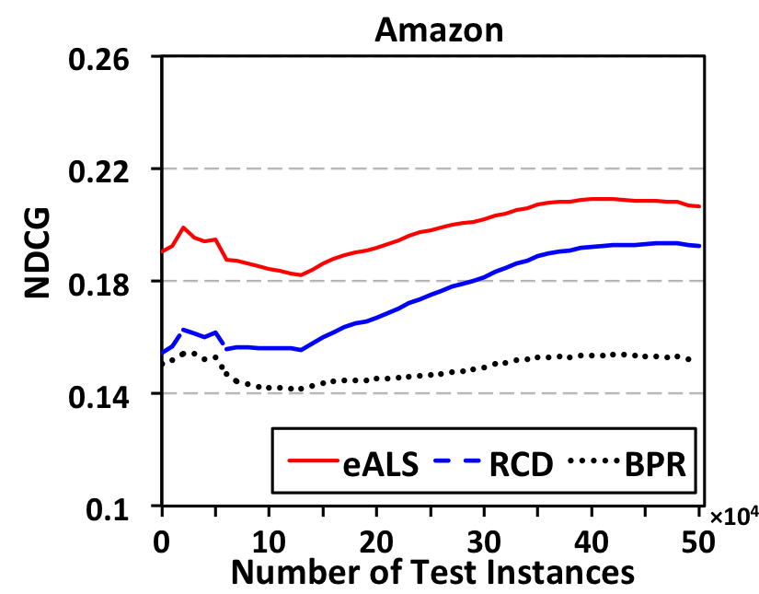
Compare dynamic MF methods
Performance evolution w.r.t. number of test interactions:
Observations:
1. Our eALS consistently outperforms RCD (Devooght et al, KDD’15) and BPR
2. Performance trend – first decreases (cold-start cases), then increases (usefulness of online learning).

Slide 29
Conclusion of Work #1
Matrix Factorization for Implicit Feedback
Model the full missing data leads to better prediction recall.
Weight the missing data non-uniformly is more effective.
Develop an efficient algorithm that supports both fast offline training and online learning.
Explore a new way to evaluate recommendation in a more realistic, better manner.
Simulate the dynamic data stream.
Our algorithm has been deployed by a startup company (Rechao 热巢) in streaming news recommendation.

Slide 30
Outline
Background
Work #1 (shallow model):
He et al. SIGIR 2016: Fast Matrix Factorization for Online Recommendation with Implicit Feedback
Work #2 (deep model):
He et al. WWW 2017. Neural Collaborative Filtering http://www.comp.nus.edu.sg/~xiangnan/papers/ncf.pdf)
Motivation
Method
Experiments

Slide 31
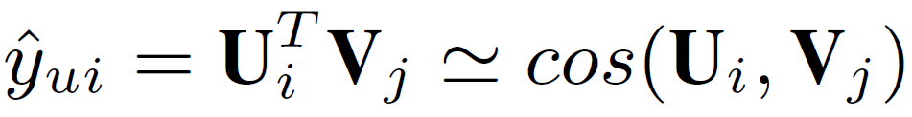
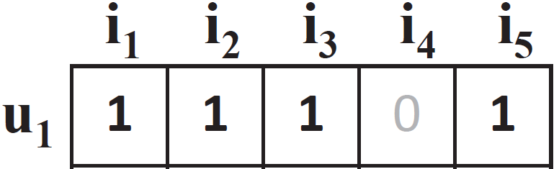
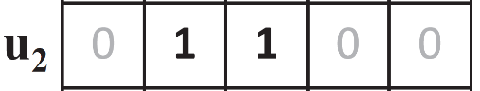
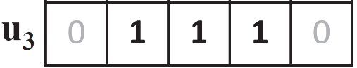
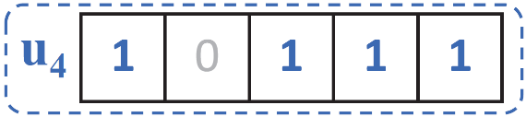
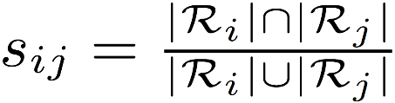
Limitation of Matrix Factorization
The simple choice of inner product function can limit the expressiveness of a MF model.
Example:
(E.g., assuming a unit length)
S₄₂ > S₄₃ (X)
u1
S₄₂ > S₄₃ (X)
sim(u1, u2) = 0.5
u2
sim(u3, u1) = 0.4
sim(u3, u2) = 0.66
u3
sim(u4, u1) = 0.6 *****
sim(u4, u2) = 0.2 *
sim(u4, u3) = 0.4 ***
Jaccard Similarity:
Notes:
However, we argue that the simple choice of inner product function can limit MF’s expressiveness.

Slide 32
Limitation of Matrix Factorization
The simple choice of inner product function can limit the expressiveness of a MF model.
Example:
The inner product can incur a large ranking loss for MF
How to address?
- Using a large number of latent factors; however, it may hurt the generalization of the model (e.g. overfitting)
Our solution: Learning the interaction function from data!
Rather than the simple, fixed inner product.
(E.g., assuming a unit length)
S₄₂ > S₄₃ (X)
u1
S₄₂ > S₄₃ (X)
sim(u1, u2) = 0.5
u2
sim(u3, u1) = 0.4
sim(u3, u2) = 0.66
u3
sim(u4, u1) = 0.6 *****
sim(u4, u2) = 0.2 *
sim(u4, u3) = 0.4 ***
Jaccard Similarity:

Slide 33
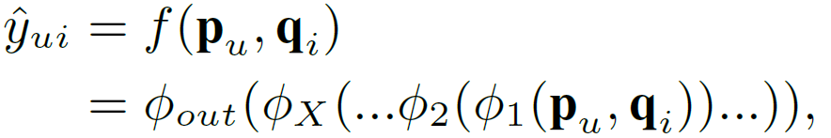
Key of this Work
Interaction function
MF: Inner Product
Ours: Learn from Data!

Slide 34
Related Work
Our work
Recommender Systems
Deep Learning
Notes:
This work tackles the recommendation problem by utilizing the deep learning techniques. As such we position our work as the intersect of the two areas. In the next, we will review some recent work that use deep learning from recommender systems.

Slide 35
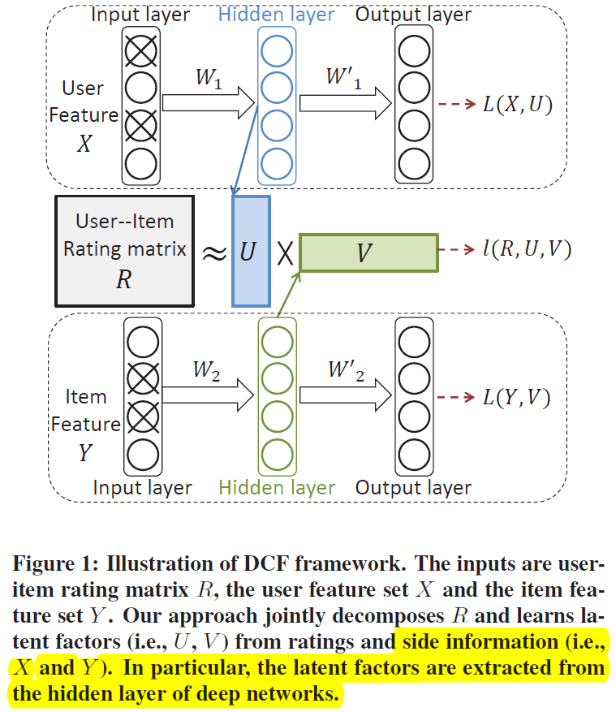
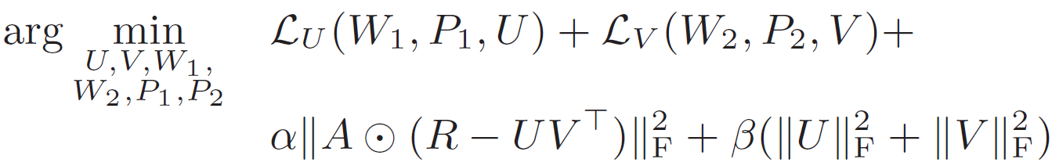
Related Work
Li et al. CIKM 2015. “Deep Collaborative Filtering via Marginalized Denoising Auto-encoder”. Work from Adobe Research.
age, gender,
city, occupation,
locations …
Optimization framework:
User features
reconstruction
Item features
reconstruction
Matrix factorization-based CF
genres, title, texts

Slide 36
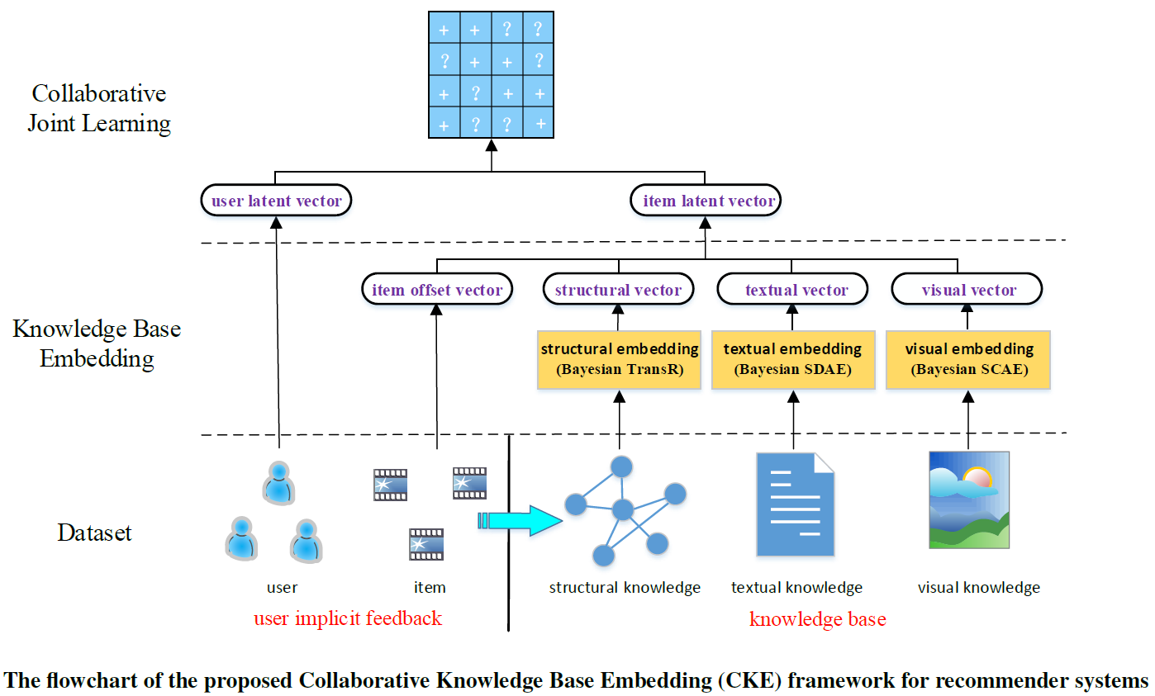
Related Work
Zhang et al. KDD 2016. “Collaborative Knowledge Base Embedding for Recommender Systems”. Work from Microsoft Research.
Inner Product

Slide 37
Summarize Related Work
Deep Learning (e.g., SDAE, CNN, SCAE) is only used for modelling SIDE INFORMATION of users and items.
For modelling the interaction between users and items, existing work still uses the simple inner product (as used in the basic MF).
Other work in a similar vein:
Y. Song et al. SIGIR 2016. "Multi-Rate Deep Learning for Temporal Recommendation“
H. Wang et al. KDD 2015. "Collaborative deep learning for recommender systems“
A. Elkahky et al. WWW 2015. "A Multi-View Deep Learning Approach for Cross Domain User Modeling in Recommendation Systems“
X. Wang et al. MM 2014. "Improving content-based and hybrid music recommendation using deep learning"
Oord et al. NIPS 2013. "Deep content-based music recommendation"

Slide 38
Proposed Methods
Our Proposals:
A Neural Collaborative Filtering (NCF) framework that learns the interaction function with a deep neural network.
A NCF instance that generalizes the MF model (GMF).
A NCF instance that models nonlinearities with a multi-layer perceptron (MLP)
A NCF instance NeuMF that fuses GMF and MLP.

Slide 39
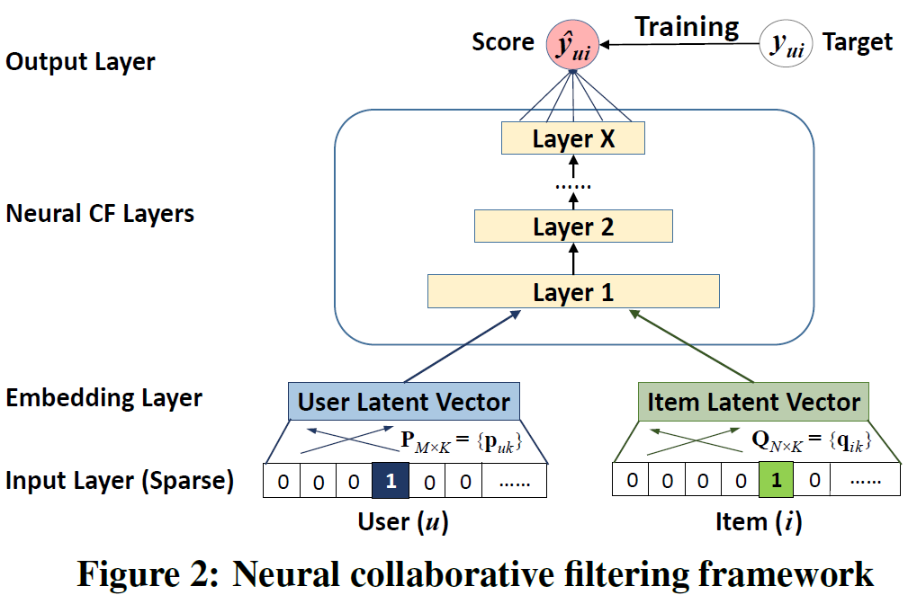
NCF Framework
NCF uses a multi-layer model to learn the user-item interaction function
Input: sparse feature vector for user u (v_{u}) and item i (v_{i})
Output: predicted score ŷ_{ui}
Note: Input feature vector can be more than just user/item ID; it can include any categorical variables, such as attributes, contexts and content.
Notes:
NCF adopts two pathways to model users and items.

Slide 40
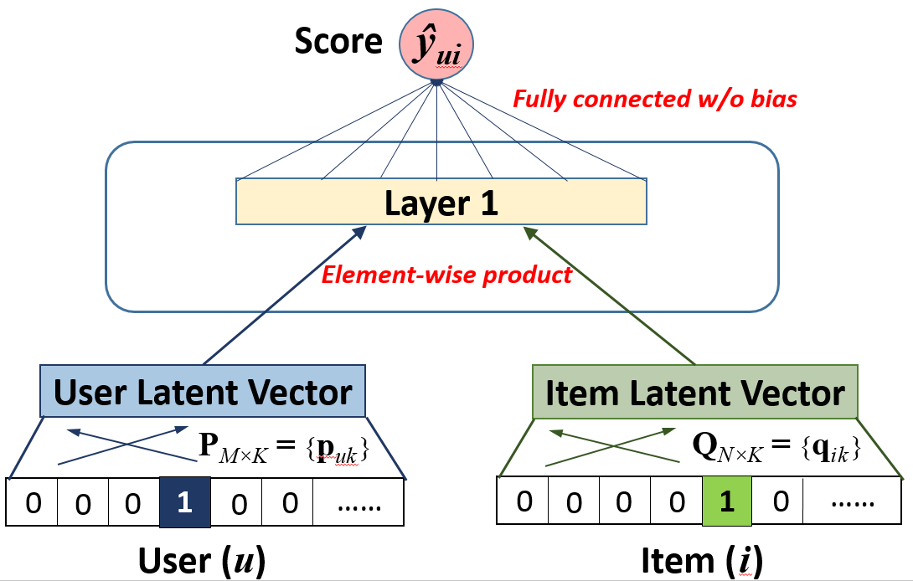
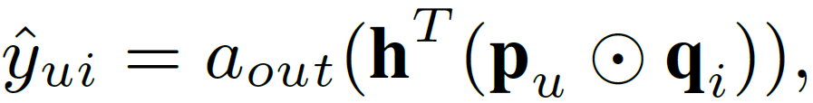
Generalized Matrix Factorization (GMF)
NCF can express and generalize MF:
Let we define Layer 1 as an element-wise product, and Output Layer as a fully connected layer without bias, we have:
Notes:
As MF is the most popular model for recommendation and has been investigated extensively in literature, being able to recover it allows NCF to simulate a large family of factorization models, such as SVD++, timeSVD and Factorization Machines.

Slide 41
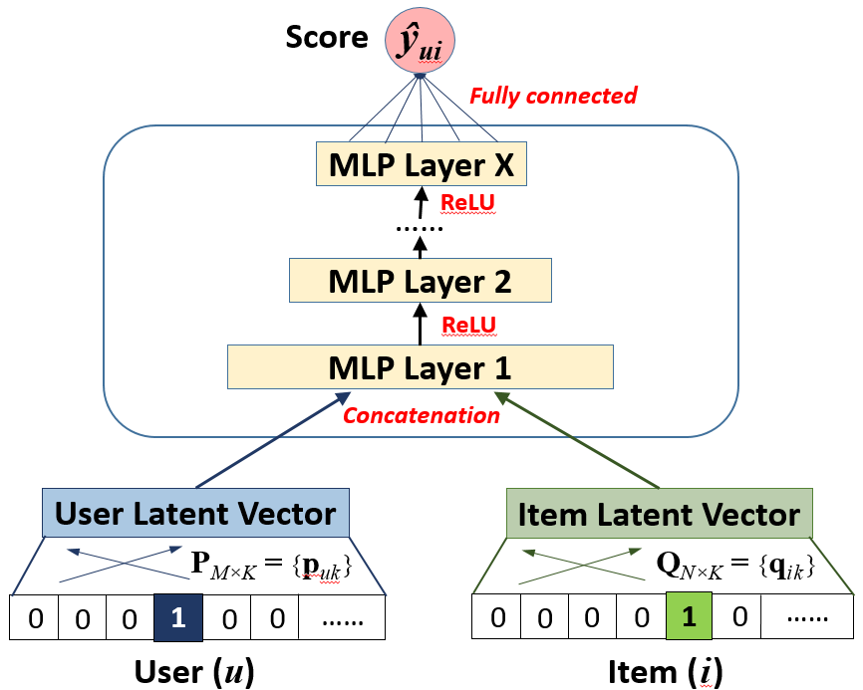
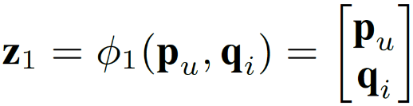
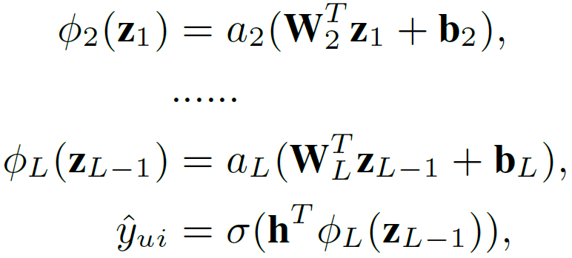
Multi-Layer Perceptron (MLP)
NCF can endow more nonlinearities to learn the interaction function:
Activation function: ReLU > tanh > sigmoid
Layer 1:
Remaining Layers:

Slide 42
MF vs. MLP
MF uses an inner product as the interaction function:
Latent factors are independent with each other;
It empirically has good generalization ability for CF modelling (best single model of Netflix and many other recommender tasks).
MLP uses nonlinear functions to learn the interaction function:
Latent factors are not independent with each other;
The interaction function is learnt from data, which theoretically has a better representation ability.
However, its generalization ability is unknown and it is seldom explored in recommender literature/challenge.
Notes:
By generalization ability, we mean a model’s prediction performance on the unknown, test data.
By representation ability, we mean a model’s ability to fit the training data.

Slide 43
MF vs. MLP
MF uses an inner product as the interaction function:
Latent factors are independent with each other;
It empirically has good generalization ability for CF modelling (best single model of Netflix and many other recommender tasks).
MLP uses a nonlinear function as the interaction function:
Latent factors are not independent with each other;
The interaction function is learnt from data, which theoretically has a better representation ability.
However, its generalization ability is unknown and it is seldom explored in recommender literature/challenge.
Can we fuse two models to get
a more powerful model?
Notes:
By generalization ability, we mean a model’s prediction performance on the unknown, test data.
By representation ability, we mean a model’s ability to fit the training data.

Slide 45
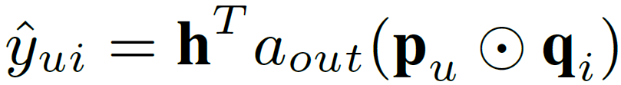
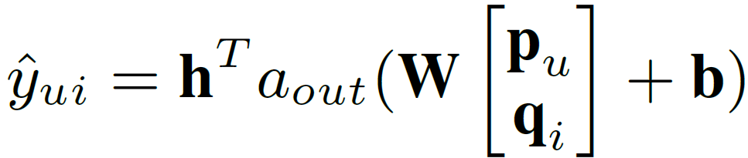
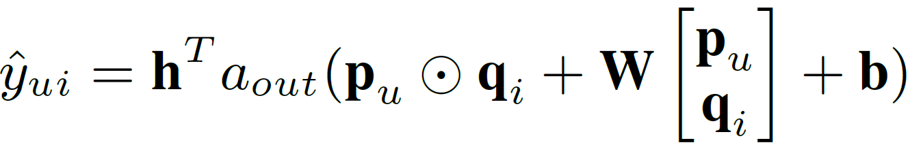
An Intuitive Solution – Neural Tensor Network
MF model:
MLP model (1 linear layer):
The Neural Tensor Network* naturally assumes MF and MLP share the same embeddings, and combines the outputs of their interaction functions by an addition:
However, we find NTN does not significantly improve over MF:
A possible reason is due to the limitation of the shared embeddings.
* Socher Richard, et al. NIPS 2013 "Reasoning with neural tensor networks for knowledge base completion"

Slide 46
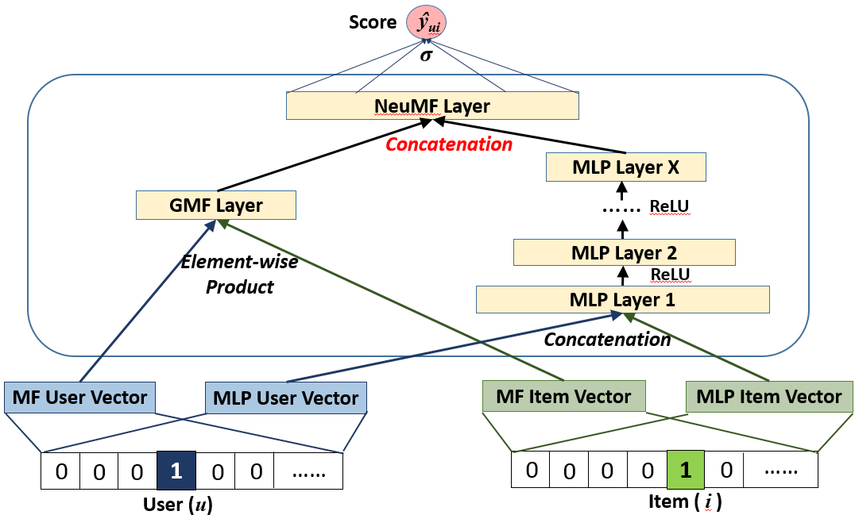
Our Fusion of GMF and MLP
We propose a new Neural Matrix Factorization (NeuMF) model, which fuses GMF and MLP by allowing them learn different sets of embeddings:

Slide 47
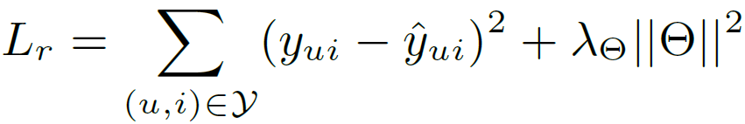
Learning NCF Models
Since NCF is a multi-layer framework, the derivative of ŷ_{ui} to a model parameter can be calculated with back propagation.
As such, regardless of the objective function, optimization can be done with SGD.
For explicit feedback (e.g., ratings 1-5):
Regression loss:
For implicit feedback (e.g., watches, 0/1):
Classification loss:

Slide 48
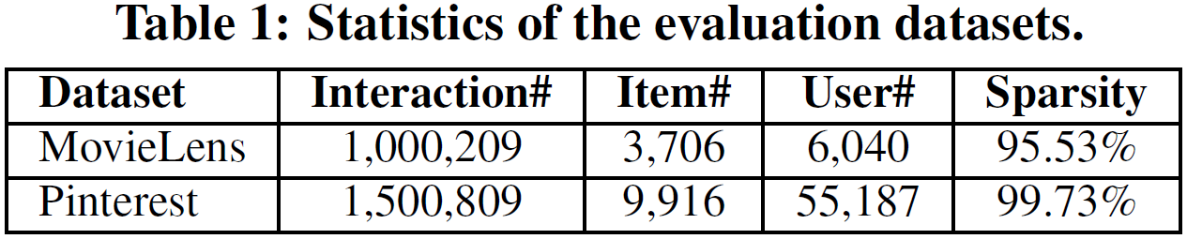
Experimental Setup
Two public datasets from MovieLens and Pinterest:
Each user has at least 20 ratings.
Transform MovieLens ratings to 0/1 implicit case
Evaluation protocols:
Leave-one-out: for each user, we holdout the latest rating as the test; the remaining data are used for training.
Top-K evaluation: rank the test item among 99 randomly sampled items that are not interacted by the user.
The ranked list are evaluated by Hit Ratio and NDCG (@10).

Slide 49
Baselines
ItemPop.
Items are ranked by their popularity judged by the number of ratings.
ItemKNN [Sarwar et al, WWW’01]
The standard item-based CF method, which has been widely used commercially, such as by Amazon and Taobao.
BPR [Rendle et al, UAI’09]
Bayesian Personalized Ranking optimizes MF model with a pairwise ranking loss, which is tailored for implicit feedback and item recommendation.
eALS [He et al, SIGIR’16]
The state-of-the-art CF method for implicit data. It optimizes MF model with a varying-weighted regression loss.

Slide 50
NCF parameter settings
By default, 3 hidden layers are used for MLP and NeuMF
Tower structure: 32 -> 16 -> 8 (number of predictive factors)
Randomly sampled 1 rating for each user as the validation data.
Tune hyper-parameters based on validation data:
1 positive sample + 4 negative samples (uniformly random)
GMF and MLP are trained from scratch and optimized with Adam;
NeuMF is initialized with pre-trained GMF and MLP and optimized with plain SGD;
Mini-batch is used which seems can prevent overfitting;
The implementation is based on Keras.

Slide 51


Performance Comparison
1. NeuMF outperforms eALS and BPR with about 5% relative improvement.
2. Of the three NCF methods: NeuMF > GMF > MLP (lower training loss but higher test loss)
3. Three MF methods with different objective functions:
GMF (log loss) >= eALS (weighted regression loss) > BPR (pairwise ranking loss)
Notes:
NeuMF significantly outperforms Eals and BPR with 5% relative improvement
High expressiveness of NeuMF, and strong generalization ability. For Pinterest, a factor of 8 outperforms other methods with a large number of factors.

Slide 52

Utility of Pre-training
Relative improvement is 2.2% and 1.1% for MovieLens and Pinterest, respectively.

Slide 53




Log Loss with Negative Sampling
Tuning the negative sampling ratio is useful --- best performance is achieved around 4;
The pointwise log loss (classification-aware) is advantageous to the pairwise loss (ranking-aware)

Slide 54



Convergence Behavior
Most effective updates are occurred in the first 10 iterations;
More iterations may make NeuMF overfit the data.
Trade-off between representation ability and generalization ability of a model.

Slide 55

Is Deeper Helpful?
Even for models with the same capability (i.e., same number of predictive factors), stacking more nonlinear layers improves the performance.
- Note: stacking linear layers degrades the performance.
But the improvement gradually diminishes for more layers
- Optimization difficulties (same observation with K. He et al, CVPR 2016)
- Residual learning might help.
Kaiming He et al. CVPR 2016. “Deep residual learning for image recognition”

Slide 56
Conclusion
Most existing recommenders use shallow/linear models.
We explored neural architectures for collaborative filtering.
Devised a general framework NCF;
Presented three instantiations GMF, MLP and NeuMF.
Experiments show promising results.
Neural nets have good performance in recommendation.
Deeper models are helpful.
Future work:
Tackle the optimization difficulties for deeper NCF models (e.g., by Residual learning and Highway networks).
Extend NCF to model more rich features, e.g., user attributes, item description, contextual and temporal signals.
Notes:
Since most existing recommenders use shallow models, we believe this work opens up a new avenue of research possibilities for recommendation based on deep learning.

Slide 57
Final Thoughts on RS
For RS, academic research has been seldom deployed in industrial use, e.g.:
Taobao mainly uses item-based CF [WWW 2001].
LinkedIn uses linear regression most.
YouTube used co-view algorithm most.
Deep learning will also overturn the RS area in the next 3 years.
Deep models are much more expressive than past models.
RNNs for temporal modeling: user behaviors are naturally sequential.
There still lacks good DL solutions for sparse data prediction.

Slide 58

Thanks!

